Slide 1
Self-Funded 101
May 23, 2024

Slide 2
DISCLAIMER FOR
C.E. WEBINARS
In order to receive credit(s) for online C.E. classes, please note that you must attend the entire course and participate in all class exercises. The third-party vendor tracking your participation, Zoom, will provide Warner Pacific with your information. If you do not attend the entire course or participate in exercises, you will not receive credit.
Please also note that it may take up to 30 days to process your credit(s).

Slide 3
Self-Funded Plans Place in the Market
Self-Funded Plans
Level Funded Plans
Bundled and Unbundled Large Group (usually over 250)
Taft Hartley Trusts / MEWAs / Association Plans/Franchise Plans
Captives
PEOs
Self-funded Health Plan Options

Slide 4
True Self-Funded
Custom Built
Employer chooses which components and vendors to utilize
Employer liability for claims
The employer assumes all liability to pay for claims, but may purchase stop loss for protection
Pay Actual Claims
Instead of pre-paying maximum liability, claims are paid as incurred
Real time Savings
Employers control their money for claims
Full Benefit Customization
Benefits are fully customizable to fit the need of the employer group depending on TPA or Carrier Capabilities
Total Premium
Admin Costs
Stop Loss
Stop Loss
Aggregate Stop Loss
Individual Stop Loss
Potential Savings
Employer Liability
Actual Claims

Slide 5
Pieces of the Puzzle

Slide 6
Basic Rate Factors
Total Premium
Admin Costs
Administrative costs – Carrier or TPA
Costs associated with plan & claims administration as well as broker compensation
Aggregate Stop Loss
Protects the employer from overall claims by the entire group above a certain threshold – typically a percent of expected claims
Individual Stop Loss
Protects the claims fund from individual high cost claimants
Claims Fund
Money used to pay for claims until stop loss kicks in
Aggregate Stop Loss
Rate Breakdown
Individual Stop Loss
Claims Fund

Slide 7
Networks
$$
$$
$
$
$
National PPO
National POS
HMO
EPO
RBP

Slide 8
Reference Based Pricing
Provider bills for covered services
No network discounts are included
Medicare Reimbursement Rate
TPA or specialized vendor will determine the Medicare reimbursement rate for the given service
Reference Based Price
The plan will reimburse the provider at a percentage of Medicare based on the service provided
Claim Negotiation
TPA or specialized vendor will negotiate with provider if balance billing occurs
Full vs Partial Replacement
Networks can be used to cover providers that may be unwilling to accept an RBP model
$3,376
Discount
$2,042
130%
$1,571
100%
Employer (80%)
Member (20%)
Medicare Reimbursement Rate
Reference Based Price
Billed Charge
End Result

Slide 9
Bundled vs Unbundled
Administration
Utilization Review
Stop Loss Protection
Critical Illness/Care Management
Pharmacy Benefit Manager
Network
Wellness, Telemedicine, DPC, etc.
Carrier Selection or Employer Selection
(Or a Combination)

Slide 10
Pharmacy Benefit Manager (PBM) Alternatives
Pharmacy Benefit Managers (PBMs) negotiate rates with drug manufacturers, contract with pharmacies, manage mail orders, handle distribution, and process prescription drug claims.
Their operation is critical to controlling costs for prescription drugs in health plans.
Traditional PBMs often receive rebates from drug manufacturers during the price negotiation process ,
These rebates may or may not be passed on in full to the health plan, depending on the PBM contract.
Transparent PBMs share 100% of drug rebates with employer clients.
They also promote lower cost alternatives such as generics or less expensive brands to drive down net costs.

Slide 11
Underwriting

Slide 12
Who Bears the Risk in Different Health Plans
Fully Insured
Insurance Carrier
Employer
Level Funded
Self Funded

Slide 13
Credibility and Pooling
From a underwriting prospective, if a group is healthy and running well their claims expectations will look better with a carrier/TPA that uses a higher credibility factor in their calculations.
Group’s Claims Data
Carrier’s Pooled Claims Data
Carrier 1
100% Credible
Carrier 2
80% Credible
Carrier 3
50% Credible
Carrier 4
0%
Credible

Slide 14
How do carriers and TPAs underwrite risk?
Experience
Claims information from current and prior years that is used to project future costs
Individual Medical Questionnaires (IMQs)
Forms completed by all employees that answer health related questions about the employee and their dependents
Group Risk Questionnaire (GRQs)
A form completed by the group administrator that answers questions of known risk within the group
GRx/Curv
Engine that uses predictive models to assign a relative risk score to a group of individuals using de-identified prescription histories
Proprietary Tools (e.g. HRAE)
Tools similar to Curv that are developed/owned by the carrier
A.I. Driven Predictive Analytics
Predictive modeling that is used to project expected claims instead of evaluating specific risk
Risk Rating

Slide 15
Stop Loss Coverage

Slide 16
Stop Loss : Individual / Aggregate
Individual Stop Loss
Aggregate Stop Loss
ISL Protection
ASL Protection
$30,000
120% of expected
Claims Fund
Expected
Claims Fund
Claims Fund

Slide 17
Fully Insured vs. Stop-loss Contracts
Under a fully insured plan, a claim incurred during the plan year is still eligible for payment after the end of the plan year.
Under a stop-loss contract, a contract covers claims that are incurred and paid within the contract year.
For example a 12/12 contract means that claims are eligible that are received and paid during the 12 month contract period.
Stop Loss
Contracts

Slide 18
Contract Periods – Run Out
12
12 Months
6 Months
18
18 Months
A “run-out” period provides coverage for claims incurred during the policy year but submitted for reimbursement after the policy year ends.
For example, a policy with a 12/18 run out period means that the policy covers claims incurred during the policy year can be paid within six months after the end of the policy year.
12 Months
24 Months

Slide 19
Contract Periods - Run In
18 Months
6 Months
12 Months
A policy with a 18/12 run-in period. provides coverage for claims incurred within three months prior to the beginning of the policy year.
During this run-in period, any qualified medical expenses before the policy year start date would be eligible for reimbursement under the stop-loss coverage.
For example, an employer moves from a self-funded contract with no run out provisions to a new contract. They are concerned about claims made by employees at the end of the prior contract year being paid. The run-in period ensures that these claims are paid under the new contract.

Slide 20
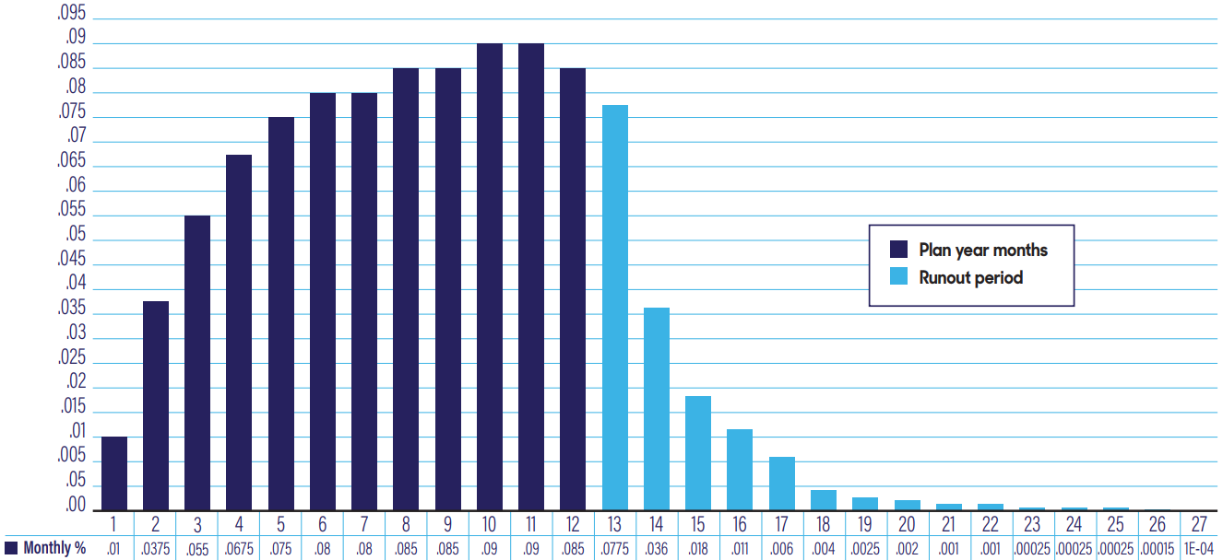
Terminal Reserve / Run Out Liability

Slide 21
Other Important Items

Slide 22
Aggregating Specific Deductible
Employers pay reduced stop-loss premiums in exchange for taking on more risk when they have an additional aggregating specific deductible.
It covers the combined large claims of multiple employees and must be satisfied before the employer can receive reimbursement from the stop-loss carrier.
Employers can potentially save money if:
Total claims above the specific deductible are less than the aggregate specific deductible.
Total claims and the aggregate specific deductible combined are less than stop-loss premiums without the additional risk in place.
Requirements:
Only claims in excess of the specific deductible apply to the aggregate specific deductible.
Claims covered under the aggregate specific deductible do not count toward the aggregate coverage.
Once the aggregate specific deductible is met, any additional eligible claims over the specific deductible will be reimbursed.

Slide 23
Aggregating Specific Deductible
$10,000
$25,000
$20,000
Aggregating
Specific
$50,000
Individual Stop Loss
$15,000
$45,000
ISL Protection
Specific
$30,000
$20,000
Claims Fund

Slide 24
Specific Advanced Funding
Employers who self-fund their group medical plans have advantages and flexibility that fully insured coverage doesn’t offer. However, they need to be prepared for larger claims and ensure they have reserves or access to funds to pay providers on time.
Stop loss is designed to reimburse policyholders when claims are higher than expected. However, it’s important to note that stop loss is a reimbursement product. Groups that self-fund must initially make all claims payments themselves and then seek reimbursement.
Advance Funding Provisions: Many stop loss carriers include advance funding provisions in their contracts. These provisions eliminate the extra step of employers borrowing funds to pay a claim and then waiting for days, weeks, or months to receive a stop loss reimbursement. Here’s how it works:
Advance funding becomes available once the policy’s specific deductible has been met.
Specific Advanced
Funding

Slide 25
Monthly Aggregate Accommodation
The Monthly Aggregate Accommodation is designed to limit the monthly aggregate claim liability for self-funded plans.
Accumulated Monthly Attachment Point: Each month, an accumulated monthly attachment point is calculated.
The accumulated attachment point increases each month as new months are added to the policy period.
Claims Exceeding Attachment Point: When claims exceed the accumulated monthly attachment point in a given month, the excess amount is sent to the employer.
Year-End Calculation: At the end of the policy period, a calculation is made to compare the total aggregate paid claims to the aggregate attachment point.
If necessary, the employer may need to refund any portion of the monthly accommodations made during the policy period.
Monthly Aggregate
Accommodation

Slide 26
Lasers
A laser is a separate, high, individual specific deductible that applies to a specific covered person under the stop loss policy.
For example, an employer is covered under a $50,000 individual stop loss (ISL) level, and one person is lasered at $100,000. The group is responsible for up to $50,000 for every employee except the lasered individual. For this individual, the employer is now responsible for up to $100,000 because they are lasered out of the policy’s $50,000 individual stop loss level.
Lasers are often used to avoid very large stop loss premium renewal increases.
Lasers

Slide 27
Lasers
$100,000
Individual Stop Loss
ISL Protection
$50,000
Claims Fund

